Slide 1

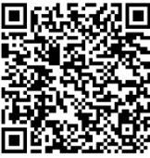


Family Connect: Ride with Confidence using Oakville Transit
Gain the skills and confidence to use public transit safely and effectively
Eligible participants: PR Card Holders, Convention Refugees and Protected Persons
Join us to:
Schedule
Friday, August 14, 2026
11:00 AM
^{Location:}
Pick up and drop off location:
HMC Oakville Office
Unit D-11, 380 Dundas Street East, Oakville, ON
Open to families (parents and kids)
Learn how to navigate Oakville transit with confidence
Explore fare payment and discount options
Increase your independence and community access
Registration Link:
Community Connections
For more information contact us:
acagas@hmcconnections.com
365 292 2541
www.hmcconnections.com

