Slide 1

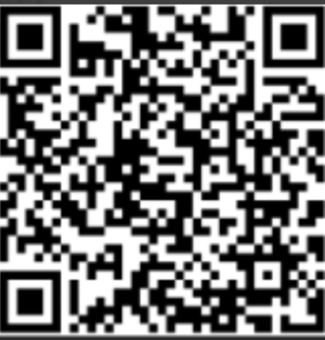


IELTS Academic Test Preparation Program
Ready to achieve your study or career goals with IELTS Academic?
Eligible participants: PR Card Holders, Convention Refugees and Protected Persons
Join us to:
Schedule
Wednesdays, 7:00 – 8:00 pm
July 15 – September 30, 2026
Requirements:
Minimum CLB 7
12-week full attendance commitment
Online Via Zoom
  Master all 4 test components: Listening, Reading, Writing and Speaking
  Build confidence with mock exams
  Access learning resources
Registration Link:
Community Connections
For more information contact us:
acagas@hmcconnections.com
365 292 2541
www.hmcconnections.com
Notes:
1

