Slide 1
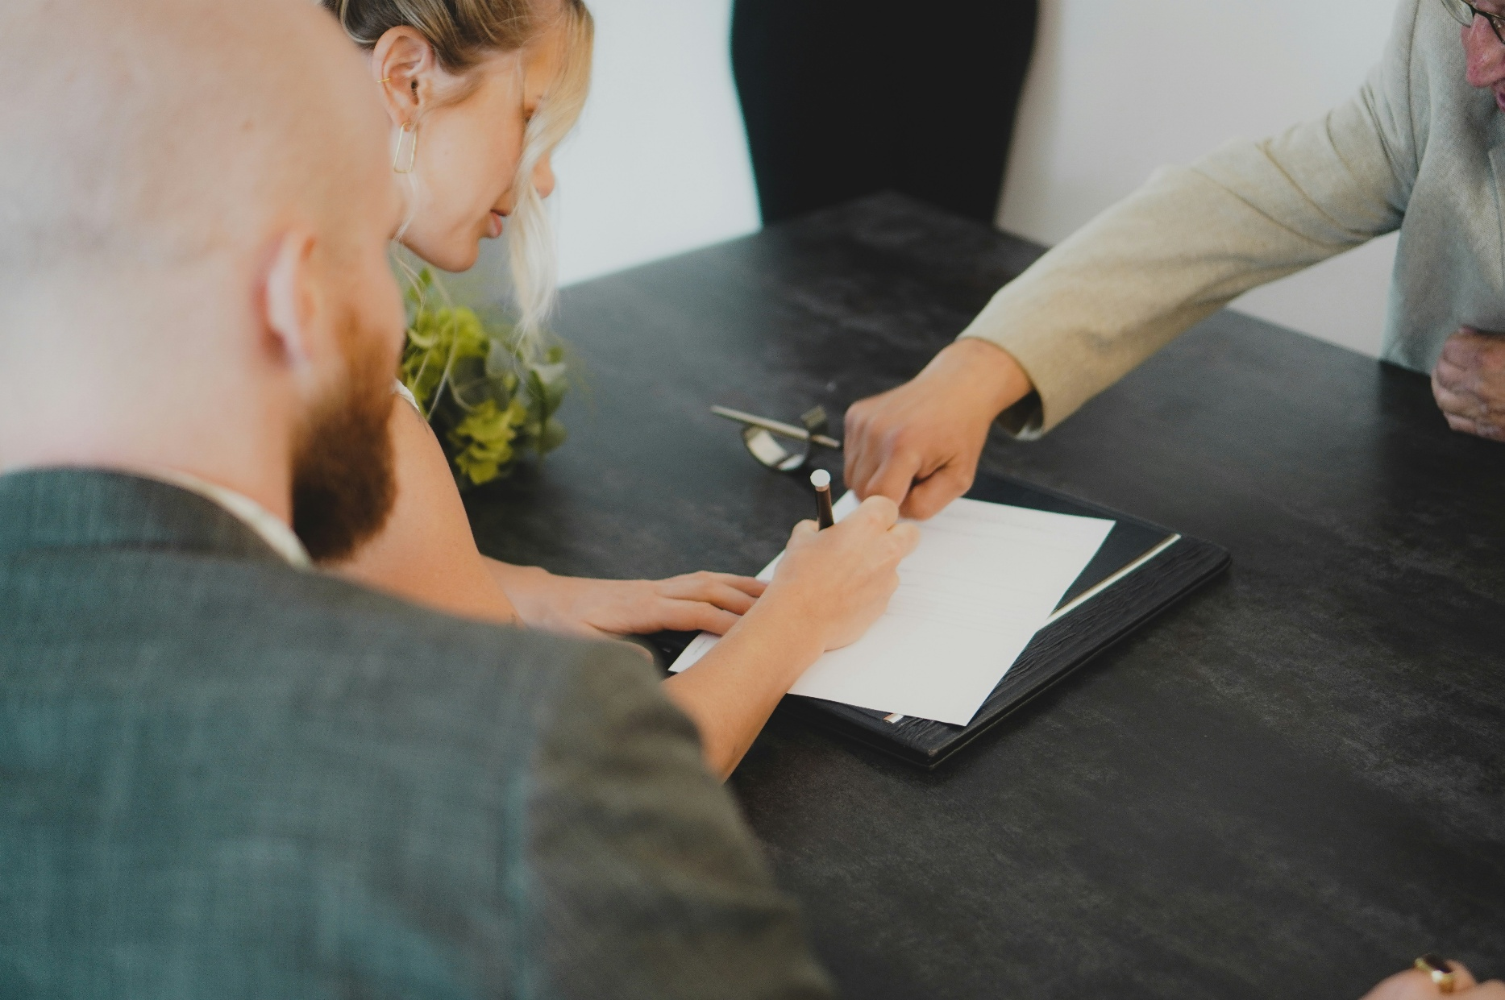
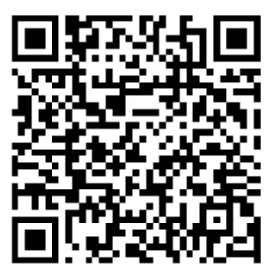

Protect Your Family- Plan Your Future
Wills & Power of Attorney
Learn How to:
Prepare a Legally valid Will
Protect your Family
Understand the Estate process
Presenter:
Junaid Kayani
Barrister & Solicitor
When:
Thursday, August 27, 2026, at 05:00 PM
Where: Online Zoom
Call Bushra Faisal at
905-464-5778
or email at bfaisal@hmcconnections.com
Register HERE or scan the QR code

