Slide 1
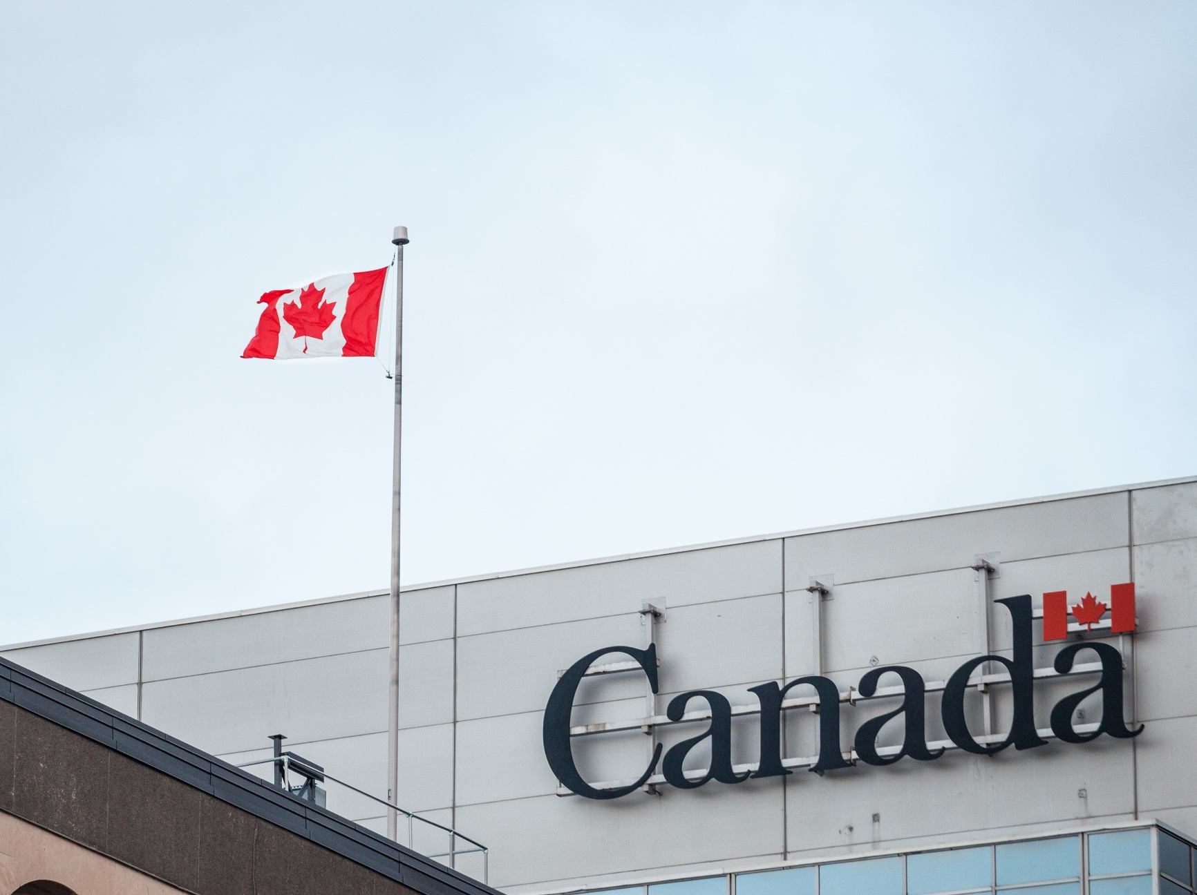

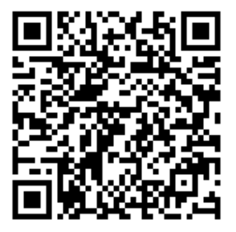
METRAC is providing vital information on Immigration updates
Recent Updates on Immigration and Refugee Law
Join us to learn about:
Bill C-12 and how it impacts Newcomers
New rules affecting Refugees
Asylum Eligibilities
Pre-Removal Risk Assessment (PRRA)
Presenter: Fatoumatta Camara
METRAC: Action On Violence
When: Tuesday Sept 15th, 2026
Time: 5:30PM Virtual Session
Registration Link: Click Here
or Scan the QR Code
For more information contact:
Zarah Felix
zfelix@hmcconnections.com
Notes:
PLEASE READ
PLEASE DOWNLOAD THE FILE, THEN EDIT!
Free HD Picture resources:
HMC Intranet
Unsplash.com
Pexels.com
Adding Background Image Instructions:
Click on the placeholder to add an image
Go to the specific folder to choose the image
P.S. RGB stand for Red Green Blue
Program Hex and RGB code guide:
SETTLEMENT & COUNSELLING: #57C8E7 -- R: 87 G: 200 B: 231
COMMUNITY CONNECTIONS: #F294CD -- R: 242 G: 148 B: 205
MENTORSHIP PROGRAM: #F19F53 -- R: 241 G: 159 B: 83
EMPLOYMENT SUPPORT: #8C85C9 -- R: 140 G: 133 B: 201
HOUSING: #DE8797 -- R: 222 G: 135 B: 151
CAREER ACCELERATOR PROGRAM: #7ADED4 -- R: 122 G: 222 B: 212
ENGLISH TRAINING: #FED671 -- R: 254 G: 214 B: 113
REFUGEES SUPPORT: #B7DC78 -- R: 183 G: 220 B: 120
INTERPRETATION & TRANSLATION: #E04942 -- R: 224 G: 73 B: 66
Other pointers:
Please try to avoid using too much text, keep it simple and concise.
You are welcome to change the formatting of the text inside the vertical rectangle but keep in mind to keep it organized and consistent.
If your program color clashes with white text, please keep it all in black for good contrast and readability.
The white rectangle at the bottom is for the HMC Logo as well as any others you wish to add.
Once you are finished and happy with the design, export it to PDF format.

